Slide 1
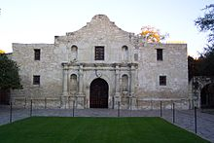

South Texas Chapter
YouTube Link - https://www.youtube.com/channel/UCx_ZOslEfrk5mObUxt5I2oA

